Slide 1
Online Course Registraion System

Slide 2
Software Requirement Specification
Introduction
Purpose:
The system allows students to:
Reigster for courses
View Semester-Specific course offerings.
Enroll in courses and cancel enrollments
Join waitlist when courses are full.
register in classes and delete registration from classes

Slide 3
Software Requirement Specification
Introduction
Project Scope:
Unique students registrations
Course browsing and enrollment for Spring, Summer and Fall Semesters.
Waitlist management
Online, accessible through major web browsers.

Slide 4
Software Requirement Specification
Description
Key Features:
User registration and login.
Course enrollment and cancellation.
Waitlist handling.
Classes registrations and deletion.

Slide 5
Software Requirement Specification
Description
Contstraints:
Built with HTML, CSS, PHP, and MySQL.

Slide 6
Software Requirement Specification
System Features
User Registration and Login:
Easy registation with username, email and password with Unique ID and password creation.
Secure login.

Slide 7
Software Requirement Specification
System Features
Courses:
Displays courses filtered by semester.
Users enroll in available courses with maximium seat limits
Adds students to waitlists for full courses and notifies them if slots open.
Allows cancellation and notifies waitlisted students.
Students register for multiple classes or delete registrations.

Slide 8
Software Requirement Specification
External Interface and Requirements
User Interfaces:
Login and registrations forms.
Courses enrollments pages
Classes student want to registere or registered within classes.

Slide 9
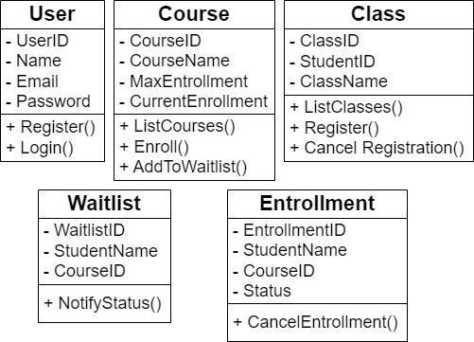
UML Diagram Models
Class Diagram

Slide 10
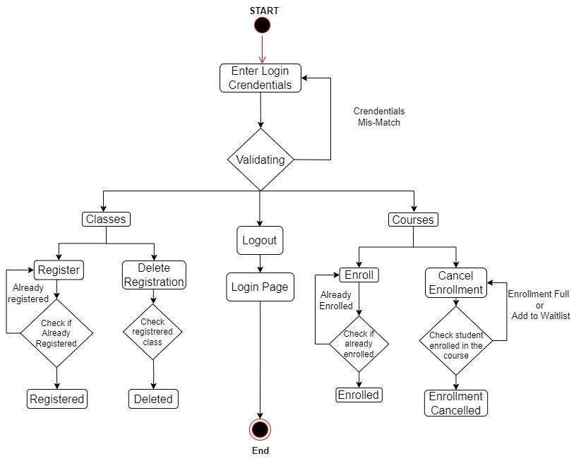
UML Diagram Models
Activity Diagram

Slide 11
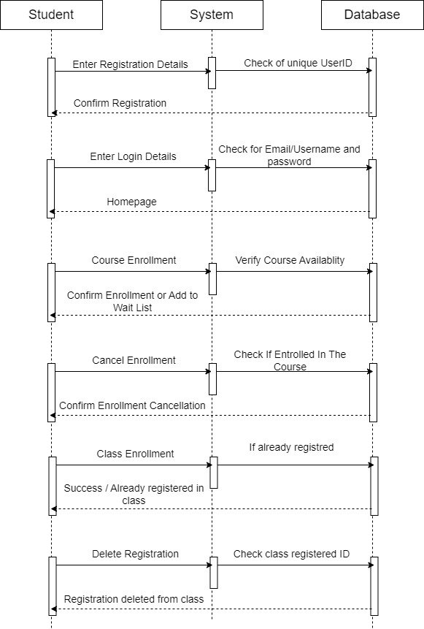
UML Diagram Models
Sequence Diagram

Slide 12
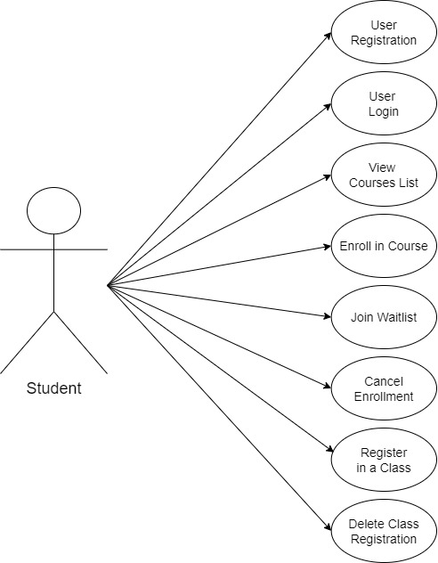
UML Diagram Models
Usecase Diagram

Slide 13
Login, Landing and Enrollment Pages
Login Page
Purpose: Allows users to securely log in to access the system features.
Login Form: Fields for email and password, a "Submit" button to validate credentials.
Validation Mechanism: Displays an error message if credentials mismatch "Credentials Mis-Match"), Redirects to the respective dashboard upon successful login.
Logout Option: An accessible button to allow users to log out (present on all logged-in pages).

Slide 14
Login, Landing and Enrollment Pages
Landing Page
Purpose: This serves as the main entry point for users to access the application.
Login Button: Prominent button redirecting users to the login page.
Navigation Options: Quick links to "Classes" and "Courses" sections (if the user is already logged in).

Slide 15
Login, Landing and Enrollment Pages
Enrollment Page
Purpose: Manages course enrollments and cancellations for users.
Enrollment Section: Shows a list of available courses with an "Enroll" button for each, f the course is full, users can be added to a waitlist, Displays a message confirming enrollment or waitlist status.
Cancel Enrollment Section: Shows a list of courses the user is enrolled in, with an option to cancel, On canceling, the system checks if the user is enrolled in the course and then confirms the cancellation.
Status Display: A summary of enrollment statuses (e.g., enrolled, waitlisted, or canceled).

Slide 16
MySql Database and Classes registration
What is MySql Database
MySQL is an open-source Relational Database Management System (RDBMS).
It uses Structured Query Language (SQL) to store, manage, and manipulate data.
MySQL is commonly used with web applications built in PHP or frameworks like Laravel and CodeIgniter.

Slide 17
MySql Database and Classes registration
Why is MySql Database?
Reliable and fast for web-based applications.
Supports relational tables, making it easier to link data like students and classes.
Free and easy to integrate with PHP.

Slide 18
MySql Database and Classes registration
Classes Registration System
A classes table was created in MySQL to store information about student registrations.
Attributes in the table: ClassID (Primary Key), StudentID (Stores the ID of the student registering for the class), ClassName (Name of the class being registered).
How it Works? A dropdown menu on the Classes page displays all available classes, Students can select one or more classes to register, When a student submits If they are already registered, an alert message notifies them “Already registered in the selected class.”, If not, their details are added to the classes table.

Slide 19
PHP Code
Reusable Design: Created a common header.php and footer.php template for consistency across all pages, Ensures a uniform look and feel for courses and classes pages.
Modular Structure: Each interface file and SQL file is separated for better code organization, This modular approach makes it easier to maintain and update the system.
Session-Based Authentication: After login, the user is redirected to the homepage only if the session is active, If the session is destroyed (e.g., the user logs out), they are redirected back to the login page.

Slide 20
PHP Code
Frontend: Used PHP to generate dynamic content, header.php and footer.php templates ensure design consistency.
Backend: Handled data using PHP functions to run SQL queries, SQL files are separate, allowing for easier management of the database structure.
Authentication: Login system with session management ensures secure access.
Code Reusability: Common templates reduce duplication and save time.
Easy Maintenance: Modular design makes the system scalable and manageable.

